Slide 1



Bio-Inspired Cementation of Soil Using Plant Enzyme
School for Engineering of Matter, Transport, and Energy; School of Sustainable Engineering and the Built Environment
Ira A. Fulton Schools of Engineering
Michael Bull³, Nasser Hamdan¹, Jeffery Fijalka²,and Sean O’Donnell¹
Research Supervisor: Professor Edward Kavazanjian, Jr.
¹Graduate Research Assistant , ² Graduate Laboratory Assistant, ³Undergraduate Researcher
ASU/NASA Space Grant Program

Slide 2
Outline
School for Engineering of Matter, Transport, and Energy; School of Sustainable Engineering and the Built Environment
Ira A. Fulton Schools of Engineering
Cementation challenges & mitigations
What is bio-inspired cementation
Benefits of bio-inspired cementation
Cementation chemistry & mechanisms
Results
Recommendations for future work
ASU/NASA Space Grant Program

Slide 3

Cementation Challenges
School for Engineering of Matter, Transport, and Energy; School of Sustainable Engineering and the Built Environment
Ira A. Fulton Schools of Engineering
Cemented mineral aggregate (e.g. concrete) is one of the most common construction materials today
Portland cement, the active binder in most concrete, is expensive & energy/CO₂ intensive
The global supply of
Portland cement is
stressed
World and Chinese Cement Consumption Trend 1990-2006 (Global Cement Report, 2007)
Global CCS Institute
ASU/NASA Space Grant Program

Slide 4
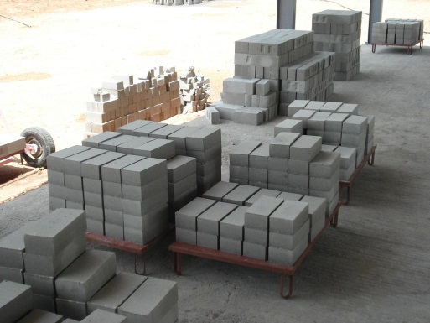
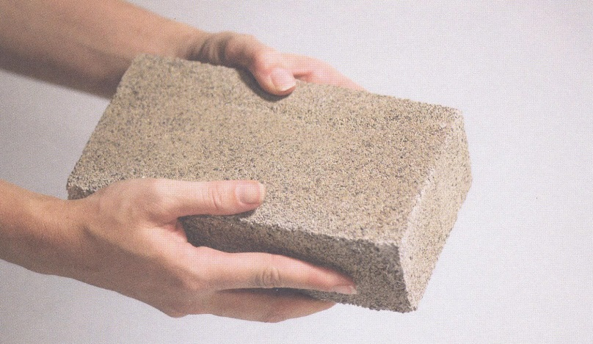
Mitigation Measures
School for Engineering of Matter, Transport, and Energy; School of Sustainable Engineering and the Built Environment
Ira A. Fulton Schools of Engineering
Increased efficiency of cement kilns & use of alternative kiln fuels and carbon sequestration
Use of supplementary cementitious materials such as blast-furnace slag & fly ash
Alternative cementation processes, including enzyme and microbial induced cementation
Fly Ash Bricks
Radco Buildtech Pvt Ltd
Microbially Cemented Brick
Ginger Krieg Dosier
ASU/NASA Space Grant Program

Slide 5

Enzyme Induced Cementation
School for Engineering of Matter, Transport, and Energy; School of Sustainable Engineering and the Built Environment
Ira A. Fulton Schools of Engineering
Carbonate precipitation via hydrolysis of urea is a potentially inexpensive cementation method
Uses common materials (CaCl₂, urea) & the enzyme urease
Requires less energy and processing steps than Portland cement
Plant derived urease is renewable & biodegradable
Smaller CO₂ footprint than cement
Jackbean
Wikimedia commons
ASU/NASA Space Grant Program

Slide 6
Enzyme Induced Cementation via Hydrolysis of Urea
School for Engineering of Matter, Transport, and Energy; School of Sustainable Engineering and the Built Environment
Ira A. Fulton Schools of Engineering
Solution of dissolved urease enzyme, urea, & CaCl₂ mixed with sand
Urease catalyzes precipitation of CaCO₃
CaCO₃ grows crystal bridges on soil grains, locking (or cementing) them into place
Cemented soil has sufficient strength & stiffness for many construction purposes
ASU/NASA Space Grant Program

Slide 7
School for Engineering of Matter, Transport, and Energy; School of Sustainable Engineering and the Built Environment
Ira A. Fulton Schools of Engineering
Concave dimple left in CaCO₃ bridge after a sand grain presumably broke away in a silica 20-30 sand sample
CaCO₃ bridging between soil grains from bio-cementation in a silica 20-30 sand sample
ASU/NASA Space Grant Program

Slide 8
Chemical Mechanism
School for Engineering of Matter, Transport, and Energy; School of Sustainable Engineering and the Built Environment
Ira A. Fulton Schools of Engineering
Urease enzyme catalyzes hydrolysis of urea CO(NH2)₂ + 3H₂O = CO₂ + 2NH₄+ + 2OH⁻
Bicarbonate occurs in a high pH environment induced by the enzyme H₂O + CO₂ = H⁺ + HCO₃⁻
Bicarbonate forms carbonate under sustained basic conditions H⁺ + HCO₃⁻ + 2OH⁻ = CO₃²⁻ + 2H₂O
Carbonate bonds with calcium & precipitates Ca₂⁺ + CO₃²⁻ = CaCO₃
ASU/NASA Space Grant Program

Slide 9
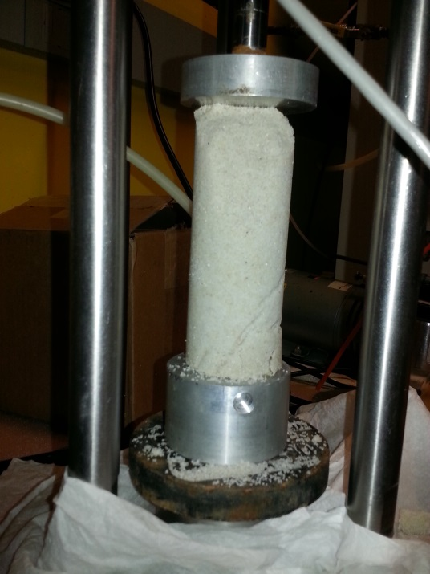
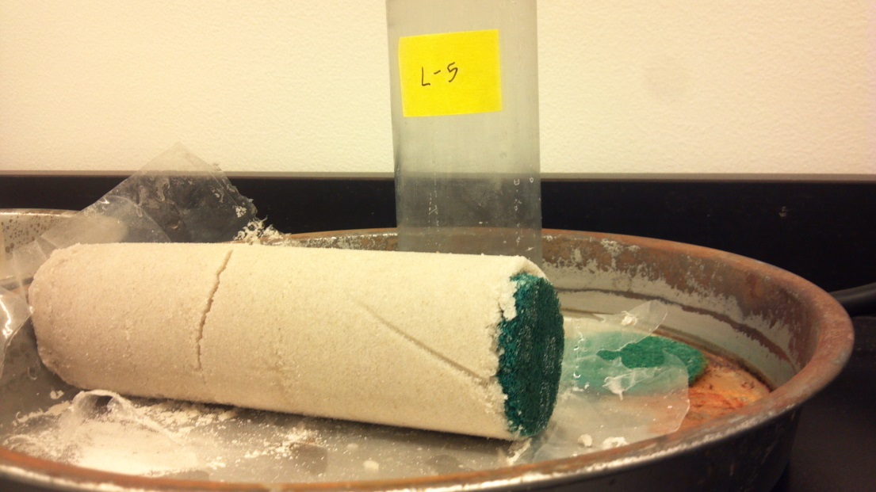
Work at ASU
School for Engineering of Matter, Transport, and Energy; School of Sustainable Engineering and the Built Environment
Ira A. Fulton Schools of Engineering
Bio-cement sand column
Test strength after rinsing to remove evaporites
Characterize with SEM, ion chromatography
Quantify weight of CaCO₃ precipitate
ASU/NASA Space Grant Program

Slide 10
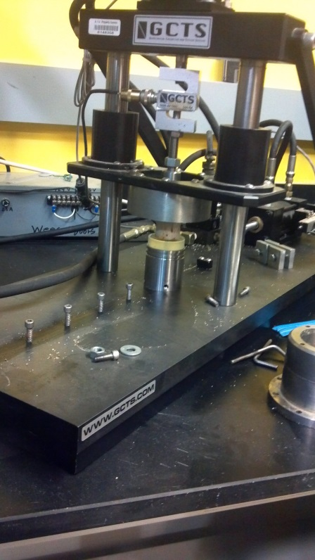
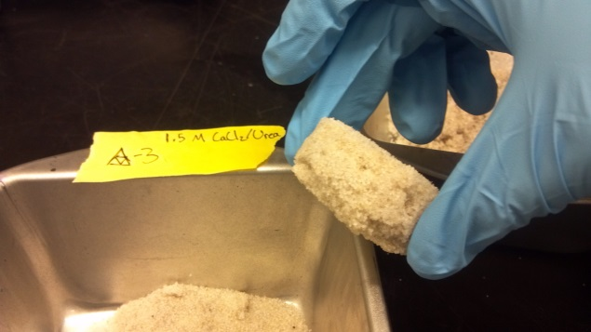
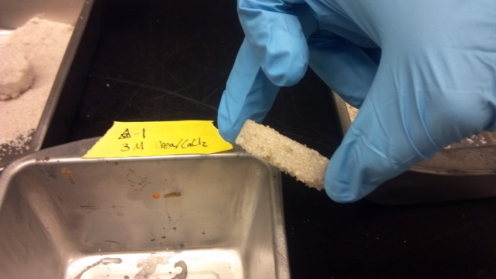
Results
School for Engineering of Matter, Transport, and Energy; School of Sustainable Engineering and the Built Environment
Ira A. Fulton Schools of Engineering
Cemented column with 76.8 psi compressive strength
Evidence of increased strength with reduction in reaction speed
ASU/NASA Space Grant Program

Slide 11
Suggestions for Future Work
School for Engineering of Matter, Transport, and Energy; School of Sustainable Engineering and the Built Environment
Ira A. Fulton Schools of Engineering
Quantify the relationship between % CaCO₃ (by weight) & strength
Test the effect of adding CaCO₃ seed crystals
Test the effect on finer & coarser grain soils
Evaluate the efficacy of simple urease extraction processes
ASU/NASA Space Grant Program

Slide 12
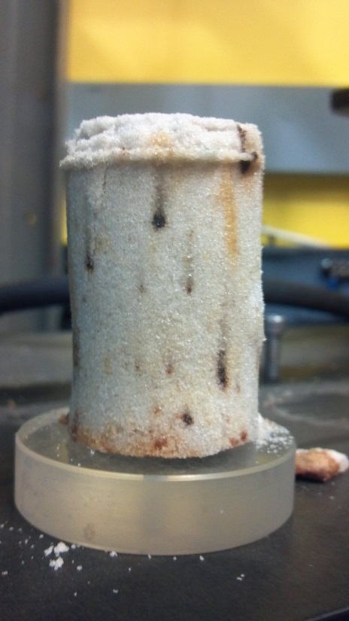
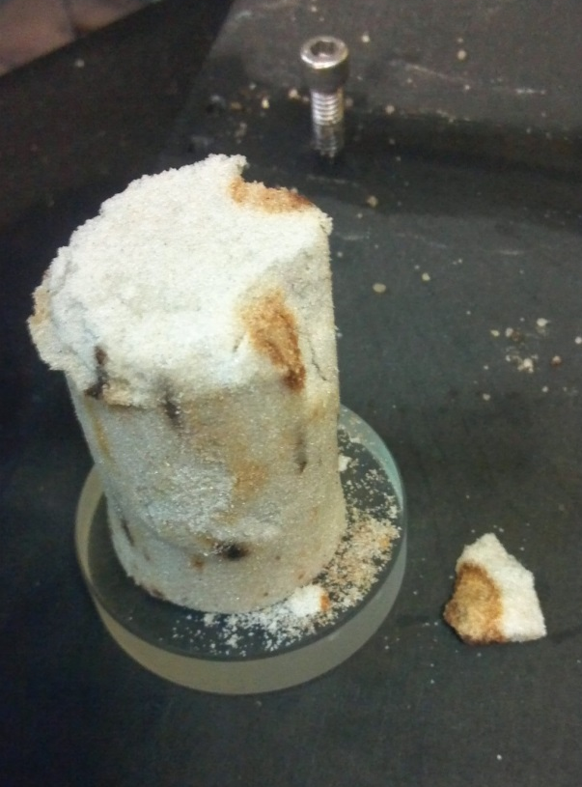
Thank you!
Comments/Questions?
School for Engineering of Matter, Transport, and Energy; School of Sustainable Engineering and the Built Environment
Ira A. Fulton Schools of Engineering
ASU/NASA Space Grant Program

